Slide 1
ESPORTS DASHBOARD
CSE-230 MOBILE PROGRAMMING
M. KISHOR - kishorm8786@gmail.com

Slide 2
ABSTRACT
Esports has gained immense popularity as a platform for gamers to showcase their talents.
The Esport Dashboard is a mobile application developed to support this passion.
The application is designed to present data in a visually appealing manner.
Java and XML are utilized to implement the functionalities of the Esport Dashboard.
The goal is to provide gamers with a comprehensive tool for showcasing their skills and tracking their progress in Esports.

Slide 3
INTRODUCTION
A mobile application, commonly referred to as a mobile app, is a software program designed specifically for use on mobile devices such as smartphones and tablets. Mobile apps are developed to offer a wide range of functions and services, catering to various needs and interests of users.

Slide 4
"Java and XML: Empowering Mobile App Development"
Java and XML synergize in mobile app development, with Java powering the app's functionality and logic, while XML defines the user interface and data structures. This combination enables developers to create dynamic, interactive apps with seamless user experiences

Slide 5

01
JAVA

Slide 6
COMPETITIVE ADVANTAGE
Seamless Integration
Compatibility
As Java has been used extensively in backend development, it offers seamless integration with backend systems, APIs, and enterprise solutions. This makes it easier to connect your mobile app with existing systems and services.
Java enjoys excellent compatibility with different platforms, devices, and operating systems. This allows Java-based mobile apps to run smoothly on various devices, ensuring a broader reach for your application.

Slide 7
PROBLEM
It is often criticized for its verbosity, which can lead to slower development. Memory management and performance optimization are important considerations, as Java's garbage collection can introduce performance issues. Dependency management and resolving version conflicts can be complex in larger projects. Additionally, Java has faced security vulnerabilities in the past, necessitating regular updates and adherence to security best practices. Despite these challenges, Java remains a popular choice due to its extensive ecosystem and community support.

Slide 8
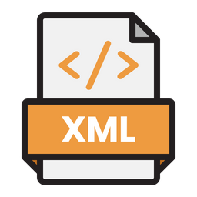
02
XML

Slide 9
XML (Extensible Markup Language)
Structure and flexibility: XML provides a hierarchical structure with customizable tags and attributes, allowing for flexible organization and representation of data.
Platform and language independence: XML can be used across different platforms and programming languages, enabling seamless data exchange and integration between diverse systems and applications

Slide 10
XML
XML AJAX
XML DOM
XML XPATH
technique used in web development to create asynchronous web applications. It combines JavaScript, XML, and HTTP requests to allow for dynamic updating of web content without requiring a full page reload.
a programming interface that provides a structured representation of an XML document, allowing developers to interact with and manipulate XML data using programming languages such as JavaScript
a language used for navigating and querying XML documents. It provides a way to select nodes and values from an XML document based on specific criteria or patterns

Slide 11
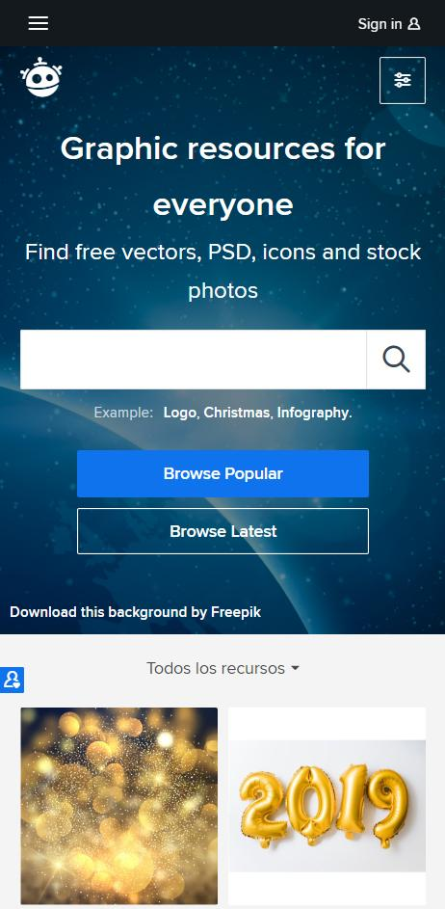
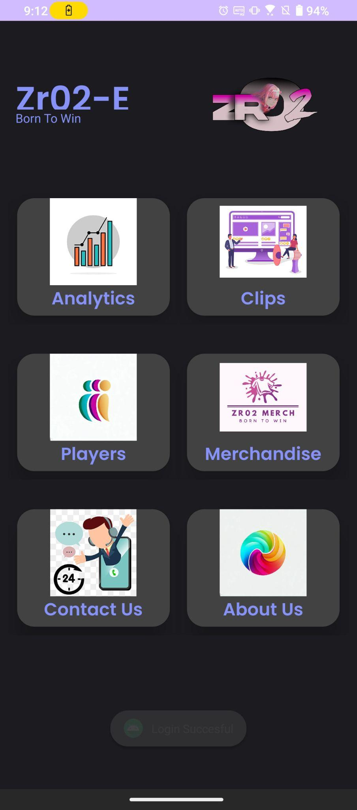
APP DEMO
INTERFACE
Esports dashboard with various activities

Slide 12
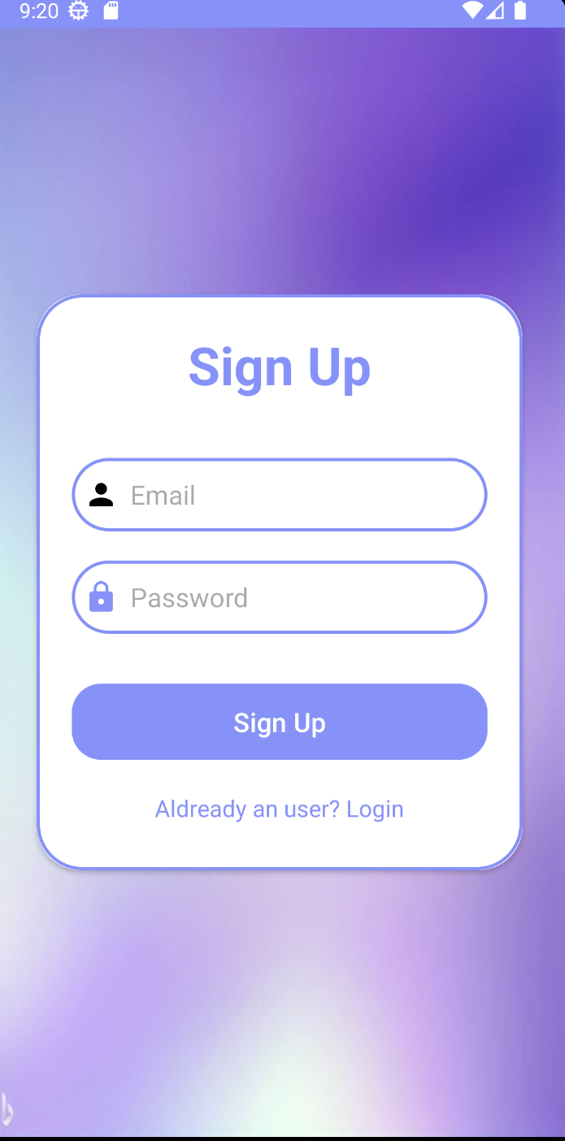
SIGN UP VIEW
Sign up view linked with firebase
NEPTUNE
Neptune is the eighth planet.

Slide 13
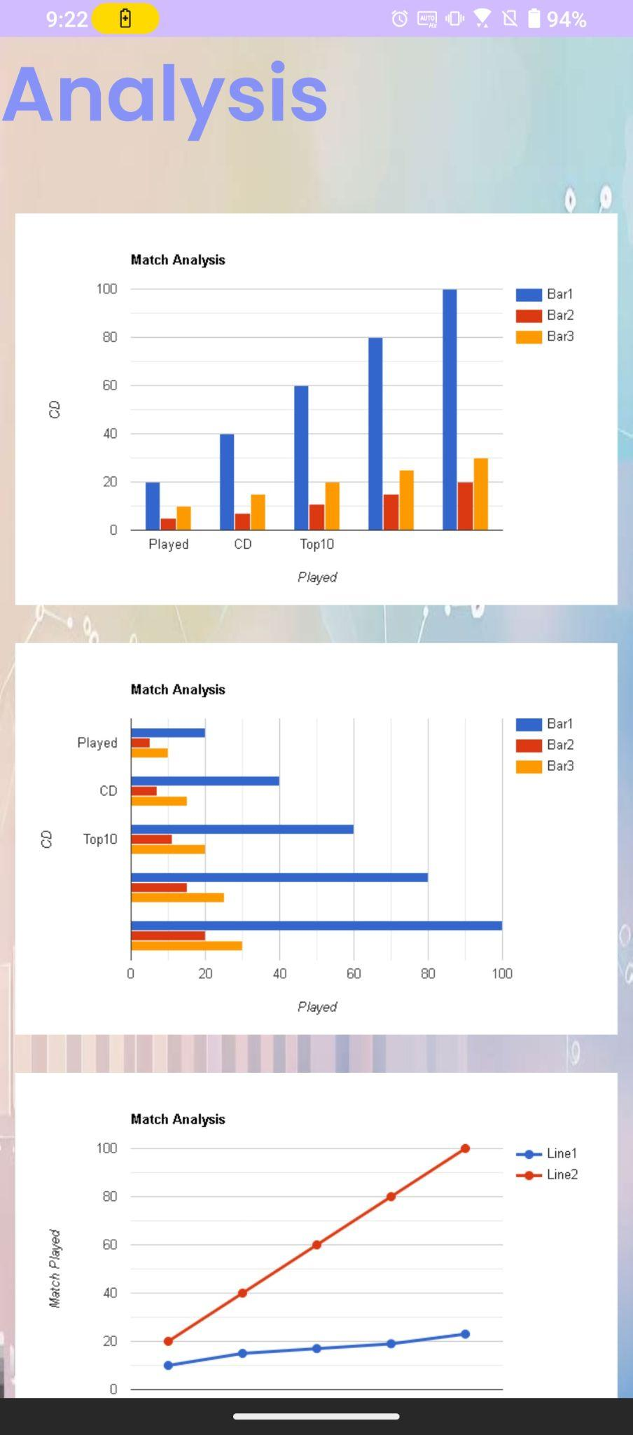

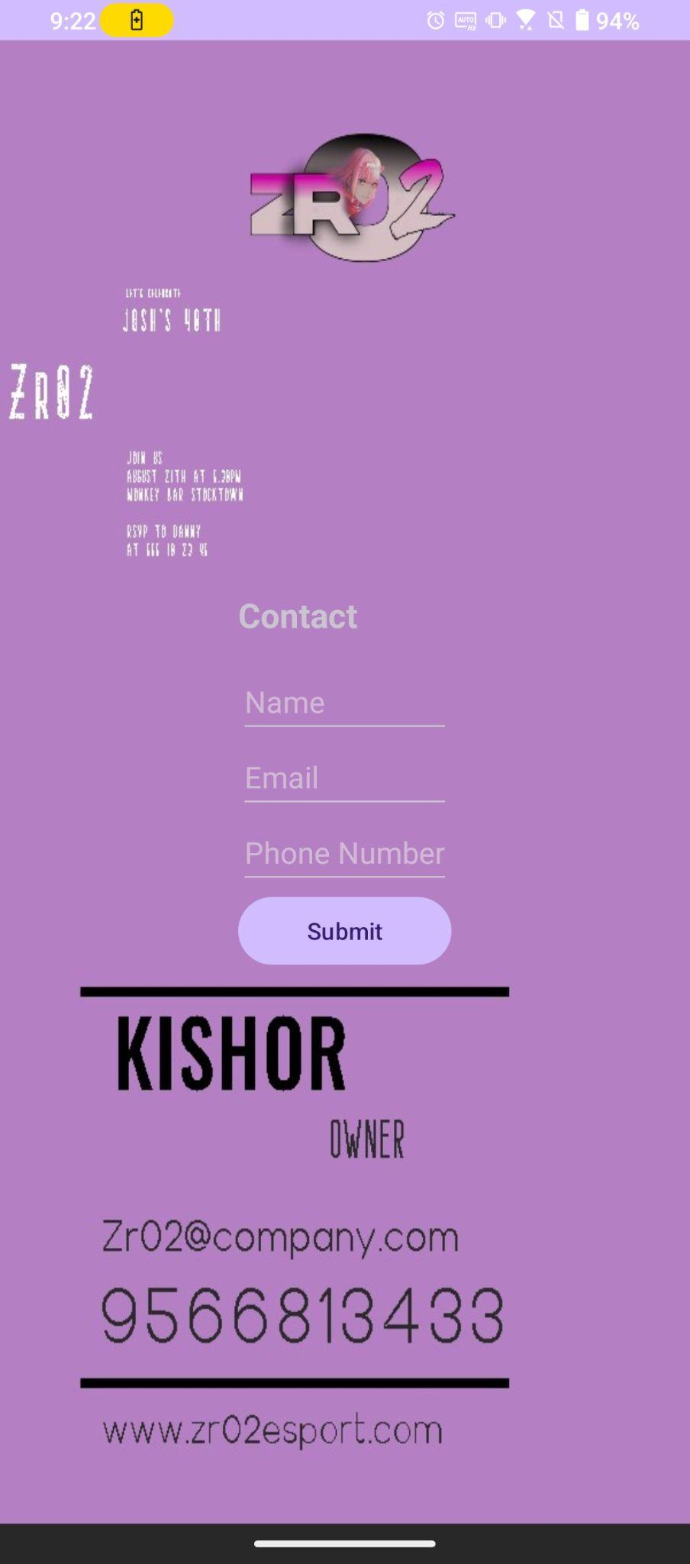
APP UI

Slide 14
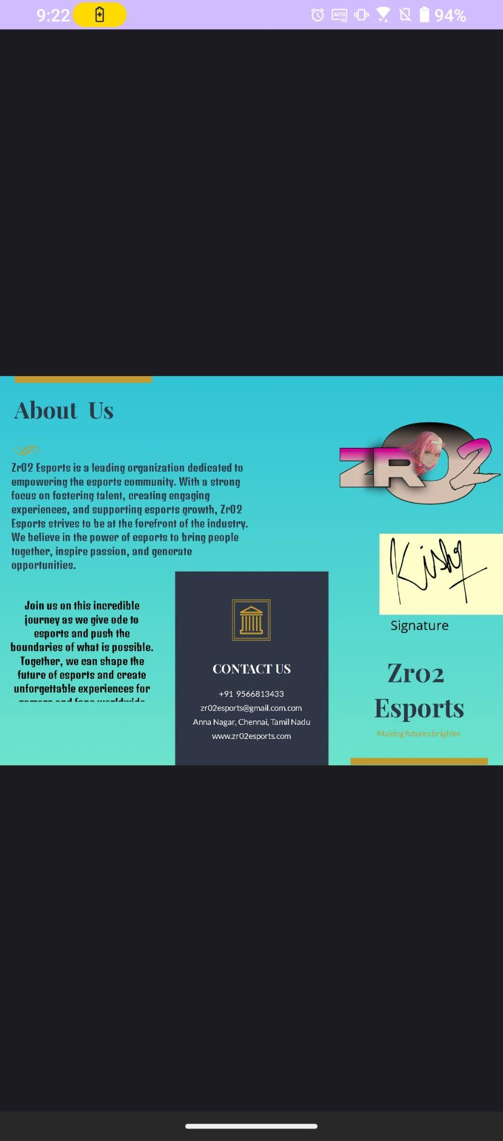
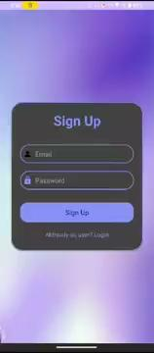

Slide 15
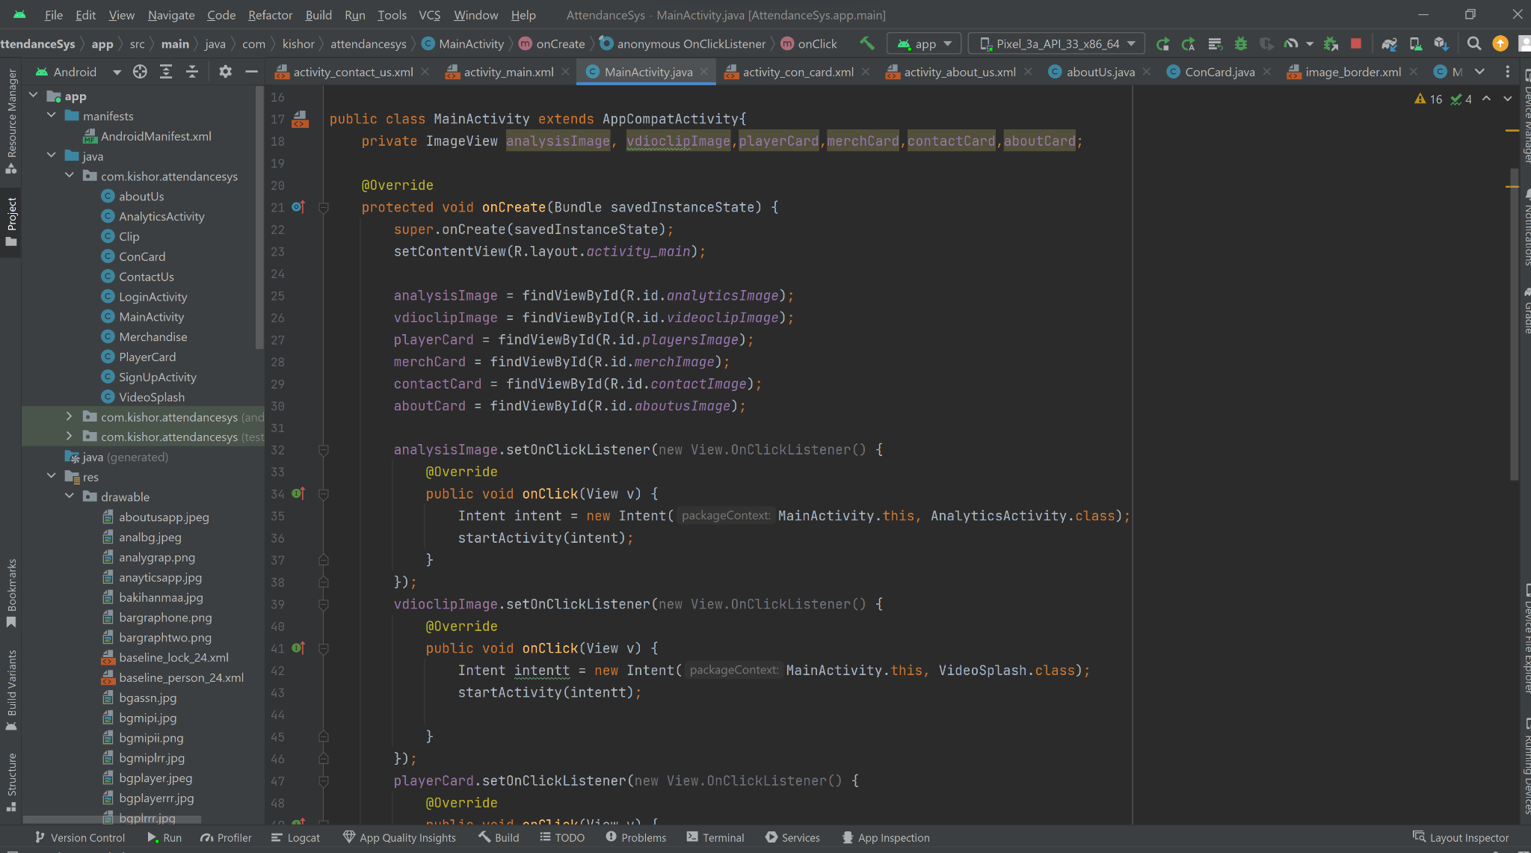
CODE

Slide 16
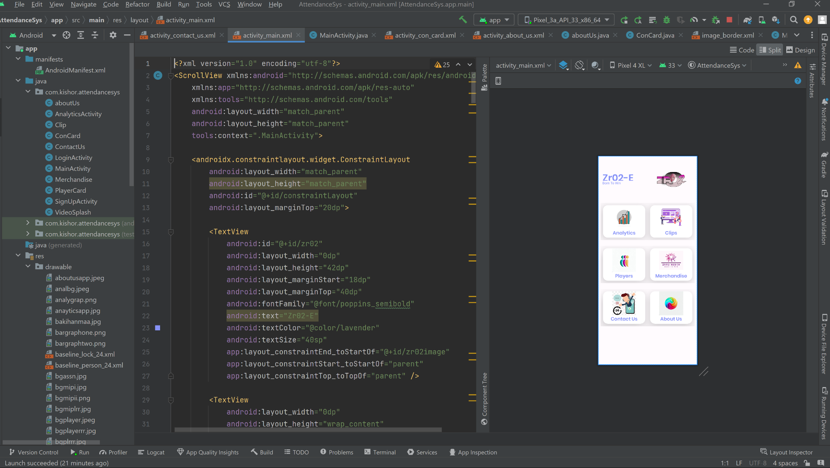

Slide 17
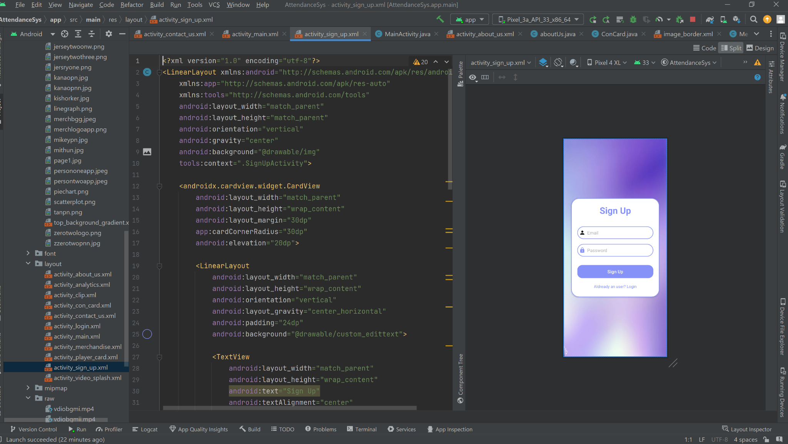

Slide 18
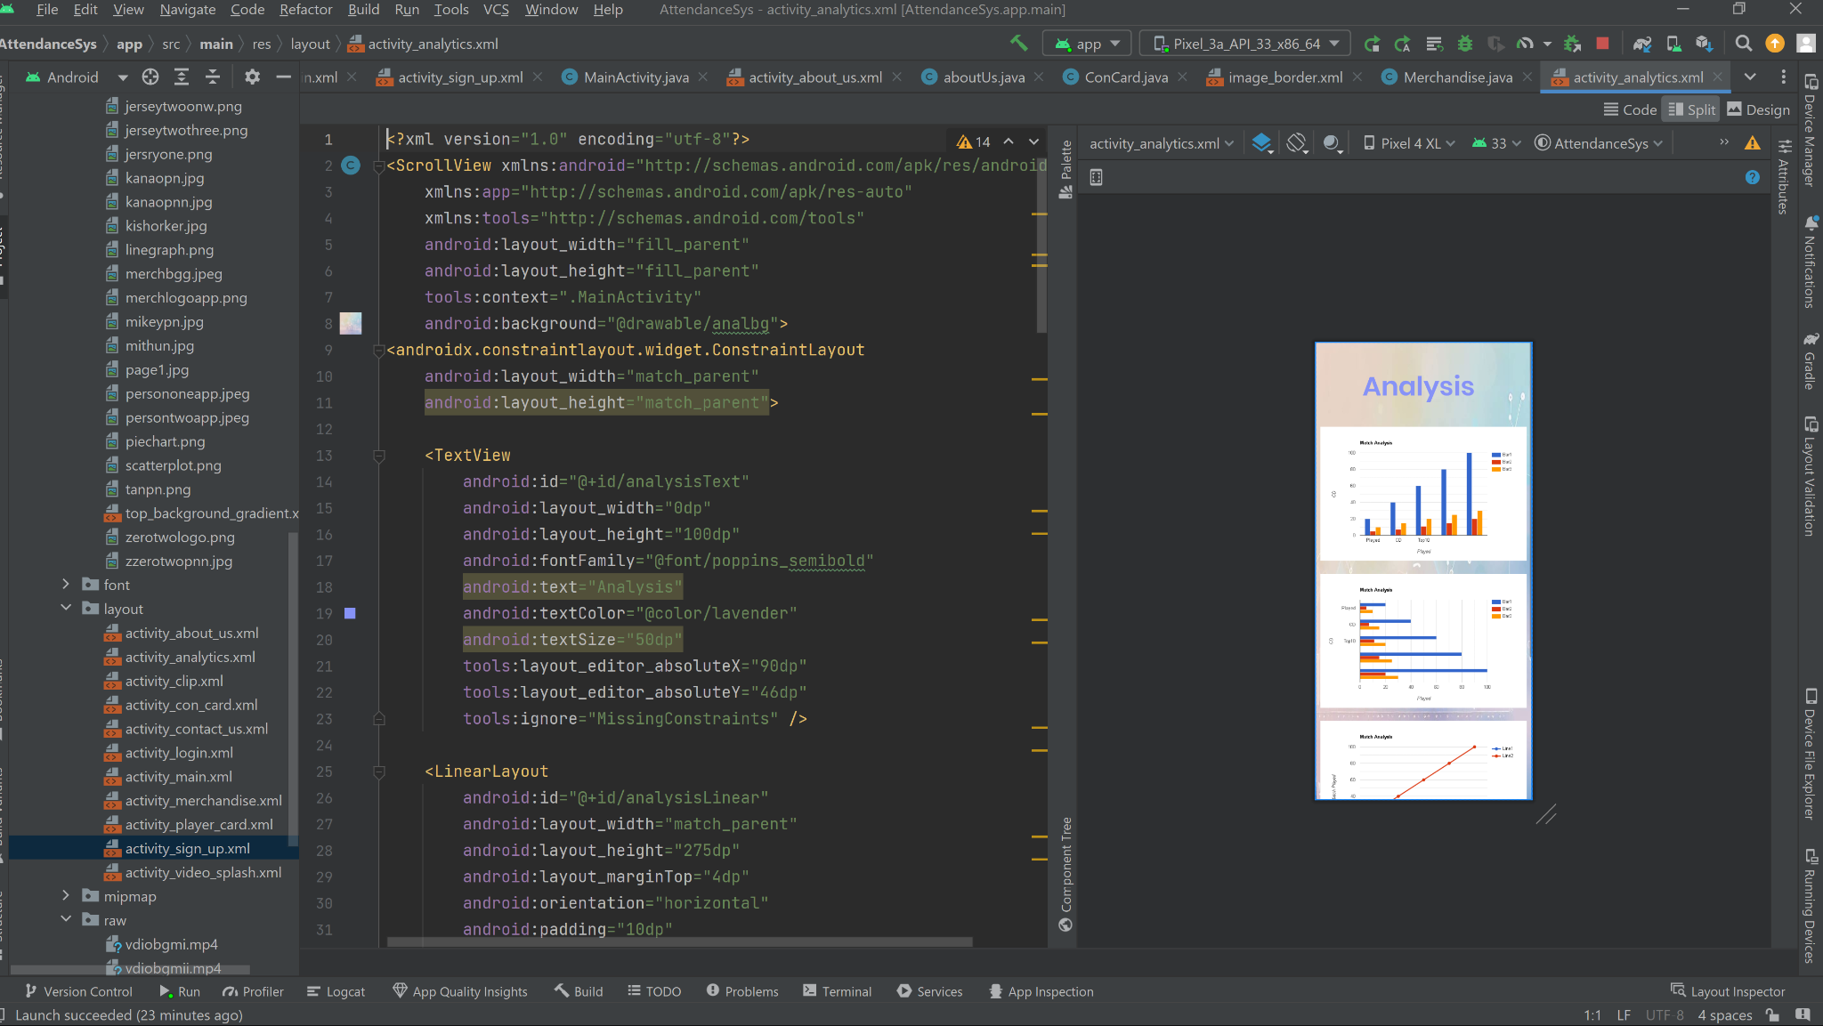

Slide 19
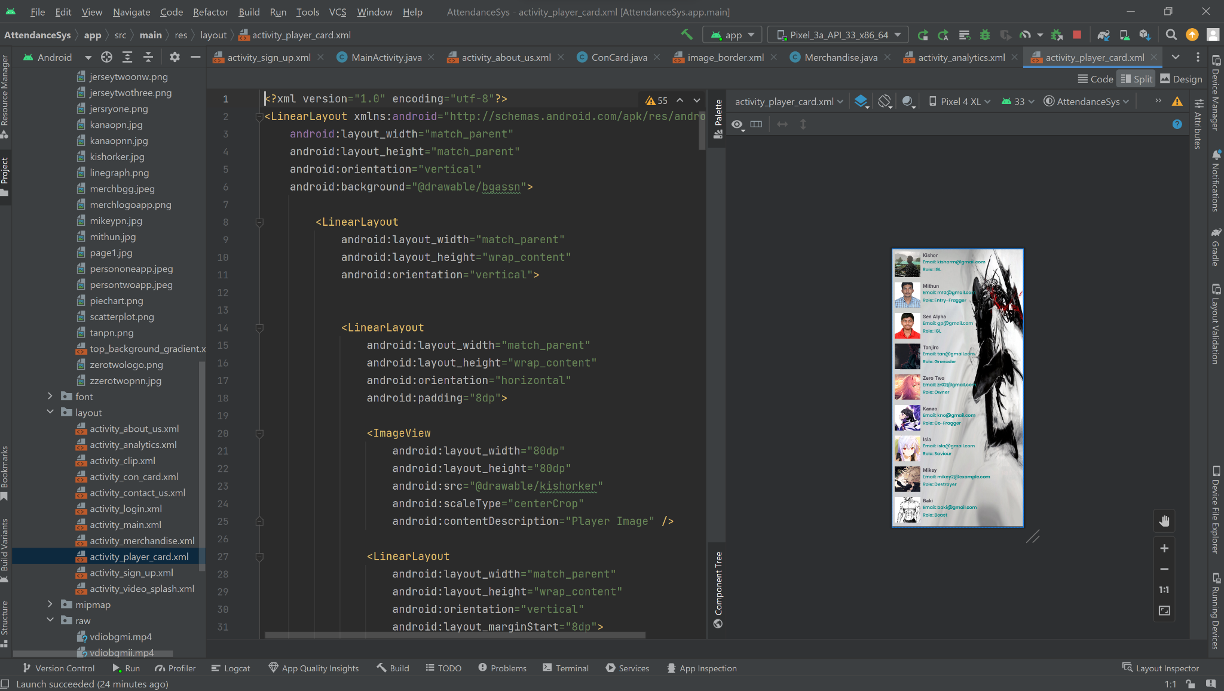

Slide 20
THANKS

